Slide 1


Surveillance and Public Health Response using Recency: Early Evidence from the Field
Getachew Tollera

Slide 2
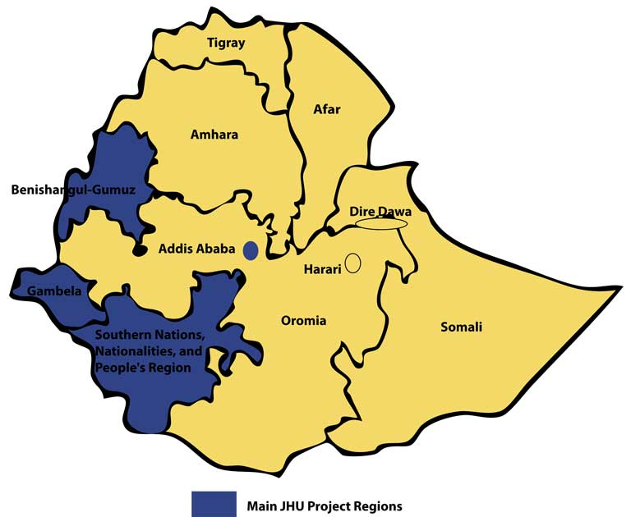
HIV in Ethiopia
HIV epidemic is major public health challenge
PLHIV 610 000 [470 000 - 780 000].
CLHIV (0-14Y): 62 000 [38 000 - 86 000]
Adult prevalence: 0.9% [0.7 - 1.2]
Prevalence varies widely residence and region <1%-4.8%
Source: EPP 18, EDHS 2016

Slide 3
Performance on 90-90-90 in Urban Ethiopia- EPHIA

Slide 4
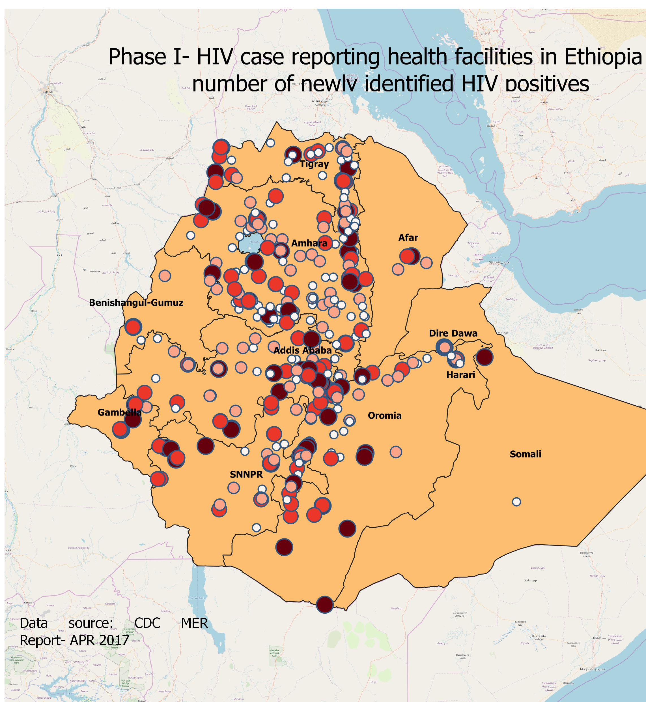

Ethiopia on the Verge of HIV Epidemic Control
  HIV case-based surveillance (CBS) will provide real-time, national and sub-national data, including recent infections, to respond to the HIV epidemic
  Allows the country program to rapidly focus the public health response to sub-populations and sites where high levels of transmission is ongoing
  435 sites to roll out CBS by September 2019

Slide 5
HIV Recency Testing in CBS
Recency status is assessed using Sedia AsanteTM HIV-1 rapid recency test as a supplemental test after positive HIV diagnosis by national HIV rapid testing algorithm
HIV recency result is not returned to the client
Used only for surveillance purpose to identify geographic hot spots and population groups with clustering of new HIV infections

Slide 6

Standard Document Development and Distribution
  National guidelines for CBS adopted in February 2018
  Includes recency testing at at all sites providing HIV testing services

Slide 7

Implementation Using Standardized Tools

Slide 8
HIV Case Reporting and HIV Recency Testing
Training for Site Staff
Region | # Sites Trained | # Staff Trained | # Sites Activated in July
Dire Dawa | 10 | 62 | TBD
SNNPR | 15 | 176 | 14
Oromia | 29 | 177 | 11
Amhara | 27 | 261 | 29
Addis Ababa | 50 | 395 | 25
Tigray | 11 | 54 | -
Total | 142 | 1125 | 79

Slide 9
Newly Diagnosed HIV Positives by Sex and by Age Category (n=69)
*Preliminary Data from 9 Sites in Addis Ababa and Amhara Regions, Jan-Feb 2019

Slide 10
Percentage of Probable HIV Recent Infections (n=64)
N=7

Slide 11
Percentage of HIV Recent Infections by Age (n=69)

Slide 12
Lessons Learned
HIV case reporting in Ethiopia is a collaborative effort between the Ethiopian PHEM and the HIV/TB directorates
Enabled us to make use of the huge human and financial resources from both departments to move the surveillance forward
Build a data flow and transmission platform, which can serve for other PHEM disease reporting as well.

Slide 13
CBS and Recency Testing in Ethiopia
Allowed the HIV program in Ethiopia to shift from measuring services in aggregates to now track hot spots of recent infections, individual interventions, and access to differentiated HIV services
  Focus on each newly identified HIV-positive individual to provide necessary interventions
  Program-level response to recent infection hot spots to prevent further transmission
Efforts will move Ethiopia closer to epidemic control

Slide 14
Acknowledgments
MoH
All RHBs
CDC
ICAP
HCBS TWG members
EPHI managment

